Slide 1
Artificial Intelligence (AI)
Topic 1: Foundations of AI and Intelligent Agents (Part- II)

Slide 2
Agenda
Agent and Environments
Rationality
PEAS(Performance measure, Environment, Actuators, Sensors)
Agent Types
Learning Outcomes : Intelligent Agents
Methodology and Assessment Criteria for the Subject

Slide 3
Intelligent Agent
Agent: entity in a program or environment capable of generating action.
An agent uses perception of the environment to make decisions about actions to take.
The perception capability is usually called a sensor.
The actions can depend on the most recent perception or on the entire history (percept sequence).

Slide 4
Agent Function
The agent function is a mathematical function that maps a sequence of perceptions into action.
[f: P* → A]
The function is implemented as the agent program.
The part of the agent taking an action is called an actuator.
environment → sensors → agent function → actuators → environment

Slide 5
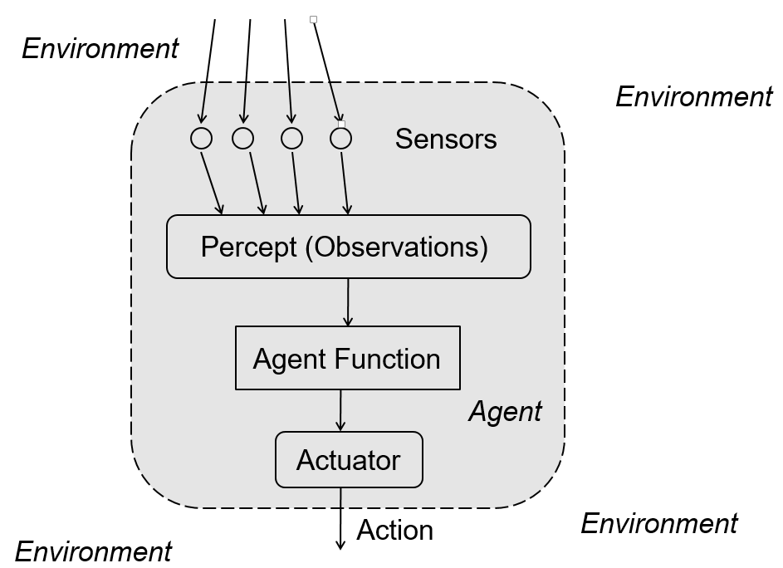

Slide 6
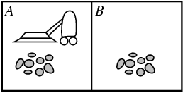
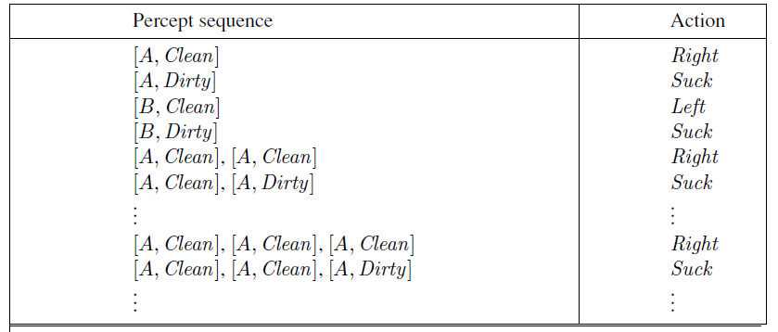
A Vaccum Cleaner Agent
Agent Function Tabulation
Percepts: location and contents, E.g., [A, Dirty]
Actions: Left, Right, Suck, NoOp

Slide 7
Agent vs Program
Size – an agent is usually smaller than a program.
Purpose – an agent has a specific purpose while programs are multi-functional.
Persistence – an agent's life span is not entirely dependent on a user launching and quitting it.
Autonomy – an agent doesn't need the user's input to function.

Slide 8
Good Behaviour: The Concept of Rationality (1)
A rational agent is one that can take the right decision in every situation.
Performance Measure :
The performance measures should be based on the desired effect of the agent on the environment and a set of criteria/test bed for the success of the agent's behavior. E.g. Awards one point for each clean square by the Vaccum Cleaner
Design Performance Measure for Agents according to what the environment wants rather than how the Agent should think !!

Slide 9
Good Behaviour: The Concept of Rationality (2)
The Agent's rational behavior or Rationality depends on:
The performance measure that defines success
The agent's knowledge of the environment
The action that it is capable of performing
The current sequence of perceptions.
For every possible percept sequence, the agent is expected to take an action that will maximize its performance measure.

Slide 10
Good Behaviour: The Concept of Rationality (3)
An agent is omniscient if it knows the actual outcome of its actions. Not possible in practice.
Information Gathering Critical for achieving Rationality
An environment can sometimes be completely known in advance.
In Exploration sometimes an agent must perform an action to gather information (to increase perception). E.g. Vaccum Cleaning in an unknown environment
In Autonomy the capacity to compensate for partial or incorrect prior knowledge (usually by learning). E.g. Vaccum cleaner for cleaning dirt

Slide 11
Task Environment
Task environments are the problems and rational agents are the solutions
Specifying the task environment
PEAS description as fully as possible
Performance
Environment
Actuators
Sensors
In designing an agent, the first step must always be to specify the task environment as fully as possible.

Slide 12
An Automated Taxi Driver (1)
Performance measure
How can we judge the automated driver?
Which factors are considered?
getting to the correct destination
minimizing fuel consumption
minimizing the trip time and/or cost
minimizing the violations of traffic laws
maximizing the safety and comfort, etc.

Slide 13
An Automated Taxi Driver (2)
Environment
A taxi must deal with a variety of roads
Traffic lights, other vehicles, pedestrians, stray animals, road works, police cars, etc.
Interact with the customer

Slide 14
An Automated Taxi Driver (3)
Actuators (for outputs)
Control over the accelerator, steering, gear shifting and braking
A display to communicate with the customers
Sensors (for inputs)
Detect other vehicles, road situations
GPS (Global Positioning System) to know where the taxi is
Many more devices are necessary

Slide 15
A Class Task
Identify a Simple Agent in your Desktop and identify sensors, actuators , purpose and Environment. Let’s Discuss in the next class !!

Slide 16
Learning Outcomes with the Topic
Understanding of Task Environments
Designing an Agent

Slide 17
Methodology And Assessment Criterias
Class Assignment(s)
Each chapter being covered will have one assignment. The Case Studies will be given in line to the Changing with Speed across IT Projects in Kirirom
Internal Exam(s)
There will be 2 exams
Model Exam
There will be one Model Exam.
Semester Exam
There will be 1 Semester Exam

Slide 18
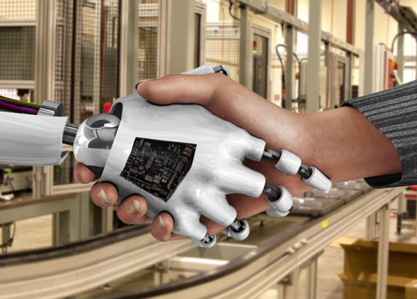
Thank You !
“Facts matter Not At All. Perception is everything it’s certainty” - Stephen Colbert

